Slide 1
BOBATHON · COGNIZANT HL7 Enablement Starter Kit for IBM ACE
Agentic AI–Driven Healthcare Messaging · IBM BOB · IBM App Connect Enterprise 12.x

Slide 2
The Problem (Why This Matters)
Healthcare systems generate thousands of HL7 messages daily. They need to be:
❌ Today (Manual / Basic) | ✅ With This Kit
Raw pipe-delimited text ignored | Parsed into structured data
No urgency triage | AI-assigned critical/high/medium/low
Routing is static | AI-driven intelligent routing
No patient context | FHIR enrichment + allergy alerts
No narrative | Granite LLM clinical summary

Slide 3
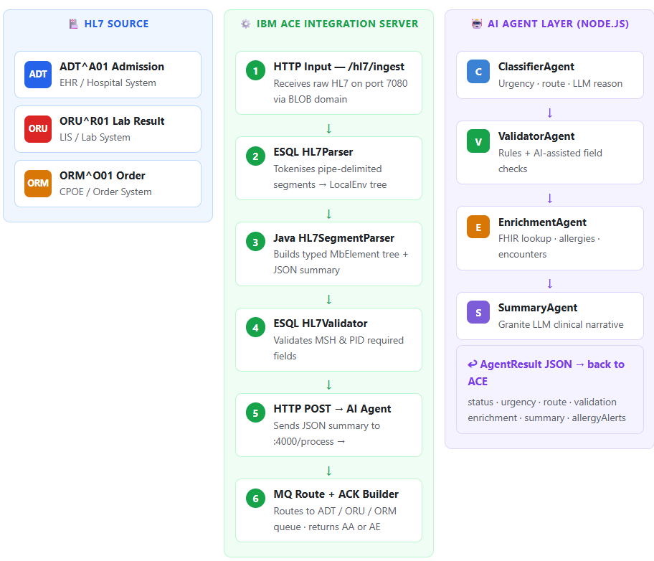
Architecture Overview
ACE handles the deterministic integration. The AI layer runs as a sidecar — independently deployable and testable

Slide 4
The 6-Step Pipeline
① HTTP Input → ② ESQL Parser → ③ Java Parser ④ ESQL Validator → ⑤ AI Agents → ⑥ MQ Route + ACK
HTTP Input — /hl7/ingest
ACE listens on port 7080 and receives raw HL7 bytes via the BLOB domain.2
ESQL HL7Parser
Splits the pipe-delimited HL7 text into a structured LocalEnvironment.HL7 element tree using pure ESQL3
Java HL7SegmentParser
A Java Compute Node that converts the raw segments into a typed MbElement tree and produces a compact JSON summary for the AI agents.4
ESQL HL7Validator
Checks that all required MSH and PID fields are present; routes the message to an error queue if validation fails.5
HTTP POST → AI Agent
Forwards the JSON summary from ACE to the Node.js AI agent sidecar at :4000/process via an HTTP Request node.6
MQ Route + ACK Builder
Puts the message onto the correct MQ queue (ADT, ORU, or ORM) and sends a standards-compliant HL7 AA or AE acknowledgement back to the sender.

Slide 5
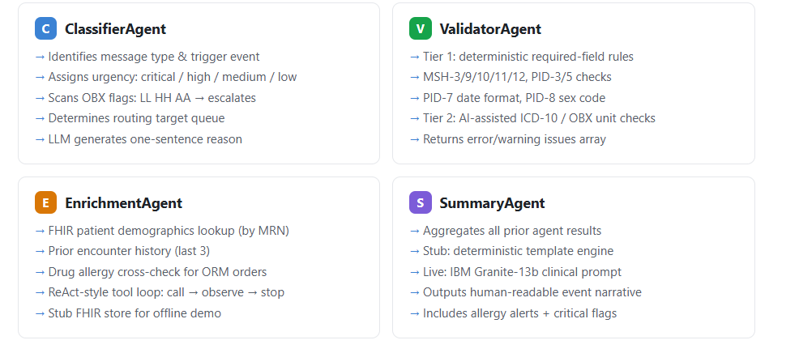
The Four AI Agents

Slide 6
Demo
Message 1: ADT^A01 → Patient Admission → urgency: HIGH → adt-queue
Message 2: ORU^R01 → Critical Lab → urgency: CRITICAL → critical-alert-queue
Message 3: ORM^O01 → Drug Order → 🚨 ALLERGY ALERT → pharmacist review

Slide 7
How It Makes Life Easier
For Integration Engineers
No HL7 library complexity inside ACE — pure ESQL keeps the BAR lightweight
For AI / Data Engineers
4 independent, fully testable AI agents — Classify · Validate · Enrich · Summarise
For Healthcare Teams
Critical lab flags (HH/LL/AA) escalated instantly — no manual triage
Drug allergy alerts fired before the order reaches the pharmacy
FHIR patient context attached to every message automatically
Human-readable clinical narratives generated by Granite LLM
Safer, faster clinical decisions — every time

Slide 8
Thank you

